Slide 1
Unsupervised Machine Learning
Online Retail Customer Segmentation
By Dhanraj A Tiwari

Slide 2
Deriving insights for the Mobile Price Range Prediction
1. Understanding the dataset with all rows and columns that what the dataset is trying to say.
2. After checking the dataset we are doing an eda in the necessary field.
3. And then checking rfm of the product according to their customer.
4. After that taking that data in one and doing an KMeans clustering.

Slide 3
Exploratory Data Analysis
1. By using describe fuction we get to know that our minimum quantity is in negative and we know that a quantity will never be in negative. So we have to remove redundancy to get better accuracy.

Slide 4
Recency, Frequency, Monetary
1. Recency is telling that recently product purchased by the customer.
2. And frequency is about fequently product purchased by the customer.
3. And monetary is no. of sales happen in the specific time period.

Slide 5
Unsupervised ML
1. In here we are using KMeans clustering technique to cluster all our data in one.
2. After that plotting the bargraph of that.

Slide 6
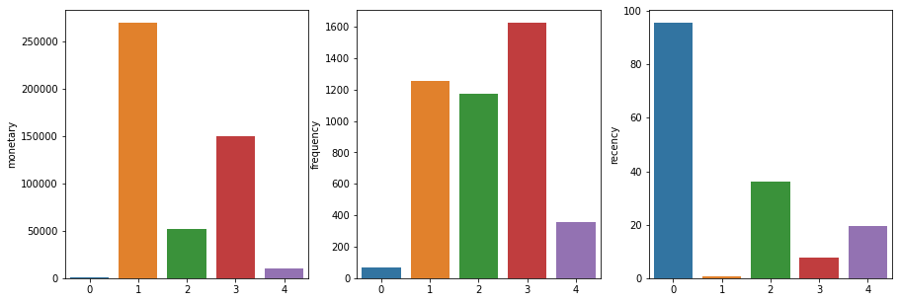

Slide 7
Refrences
https://ieeexplore.ieee.org/document/5974496

Slide 8
Thank You

